Slide 1


Introduction to Engineering
By Biniyam Tadese

Slide 2
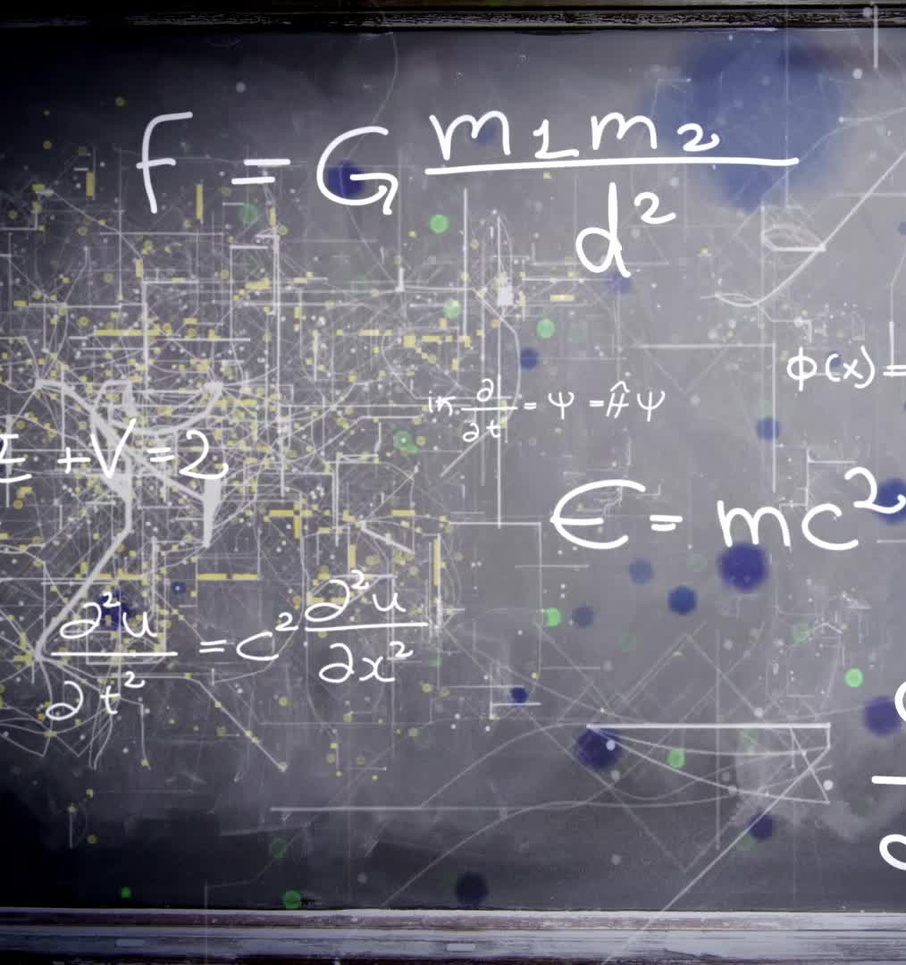
Before this pre-engineering
Some experience
Blurred image (math and engineering)

Slide 3
In a nutshell
Commencement
Software engineering
Civil Engineering
Electrical Engineering
Mechanical Engineering vs Aerospace engineering
Significant Challenges and Solutions
Benefits
Conclusion

Slide 4

For Commencement
Engineering
Major disciplines
Engineering and real-world problems
Collaboration and teamwork
Continuous learning and adaptation to new technologies.
Notes:
This slide introduces the field of engineering and its significance in society. Engineering applies science to create solutions that improve our lives. It includes various disciplines, each with unique challenges and contributions. Highlight the importance of teamwork and continuous learning, as engineers must adapt to rapidly changing technologies to remain effective.

Slide 5

Software Engineering
Overview of CS
Python as a Trigger
Trial and error
Most Important ideas
Teamwork and Kaizen

Slide 6

Civil Engineering
Course Overview
Sub fields
Applications

Slide 7

Electrical Engineering
Common Terminologies
Subfields
Huge Impact

Slide 8

Mechanical Engineering Vs Aerospace Engineering

Slide 9

Comparison
Major Distinction
Future Prospects
Subfields
Applications

Slide 10

Significant Challenges and Solutions
Major Problems
Interface with the real world
Solutions as an Engineer

Slide 11

Benefits
As a professional
Socio-economic
Future Renaissance

Slide 12
After this pre-engineering
Strange online platform
New assessment system
Appropriate planning
Experience share

Slide 13

Thank You for your time

